Slide 1
Software Testing at CMED Health Ltd.
Supervised By:
Dr. Farhana Sarkar
Assistant Professor and Course Coordinator
Department of Computer Science and Engineering (CSE)
University of Liberal Arts Bangladesh (ULAB)
Presented By:
Imtiaz Ahmed Chowdhury
ID:161014052
Department of Computer Science and Engineering(CSE)

Slide 2


COMPANY PROFILE
Name :CMED Health Limited.
Website :cmed.com.bd
Nature of Business :Smart health monitoring system for regular health monitoring.
Services :Primary health monitoring, Workforce wellness program (WWP), Cloud based record system, CMED e-prescription, etc.

Slide 3

COMPANY OVERVIEW
CMED Health Limited is a health tech company focusing on preventive healthcare. It was established on 2016. CMED is a smart health monitoring system for regular health monitoring. CMED uses smart medical sensors connected to a smartphone for measurement of vital signs and store data to its secured cloud server. Users will get instant feedback about their health status

Slide 4
DUTIES and RESPONSIBILITIES
Web Testing
App Testing
API Testing
Testing website for potential bugs before its made live and is accessible to general public. In this process CMED focused on functionality, usability, security, compatibility, performance of the web application.
Testing mobile applications for providing applications to users for great and smooth performance. In this test process, the main priority is user interface, functionality, usability and consistency.
API is a collection of software functions and procedures which can be executed by other software applications. In this testing main focus is functionality, not on behavior or customer experience

Slide 5
SOFTWARE TESTING
In CMED, they have been using manual testing mostly because testing is a complex process. Sometimes, real human experience can deliver the
results we want.
CMED use manual testing to ensure that the
final product really works as intended. With a
specific role to play, manual testing is used to
explore use-cases that may not be all
that obvious.
Software testing is defined as an activity to check whether the actual results match the expected results and to ensure that the software system is Defect free. Software testing also helps to identify errors, gaps or missing requirements in contrary to the actual requirements. It can be either done manually or
using automated tools.

Slide 6
Internship Activities/Works
Wrote basic test cases and checklist for testing and tested basic functionalities according to test cases and checklist.
Tested mobile and web application of Help Age in depth for system bug.
Provided support in testing for multiple projects including CMED Corporate, Tottho Apa , ENRICHed SASTHO(PKSF), Sontusti , and CMED user app and web dashboard.

Slide 7
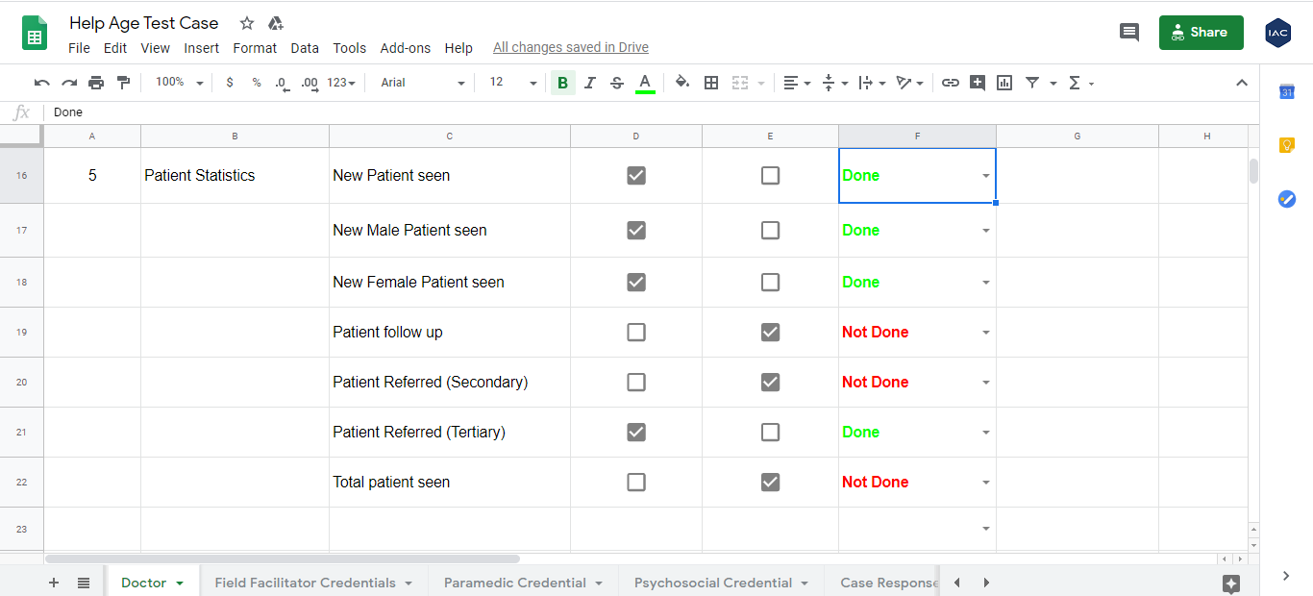
Checklist of HelpAge Doctor Credential

Slide 8
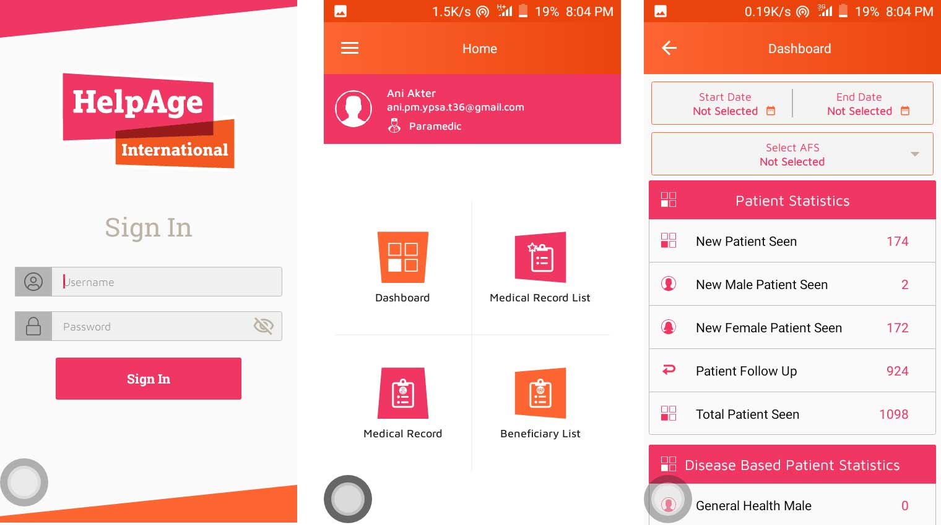
HelpAge Mobile Application UI

Slide 9
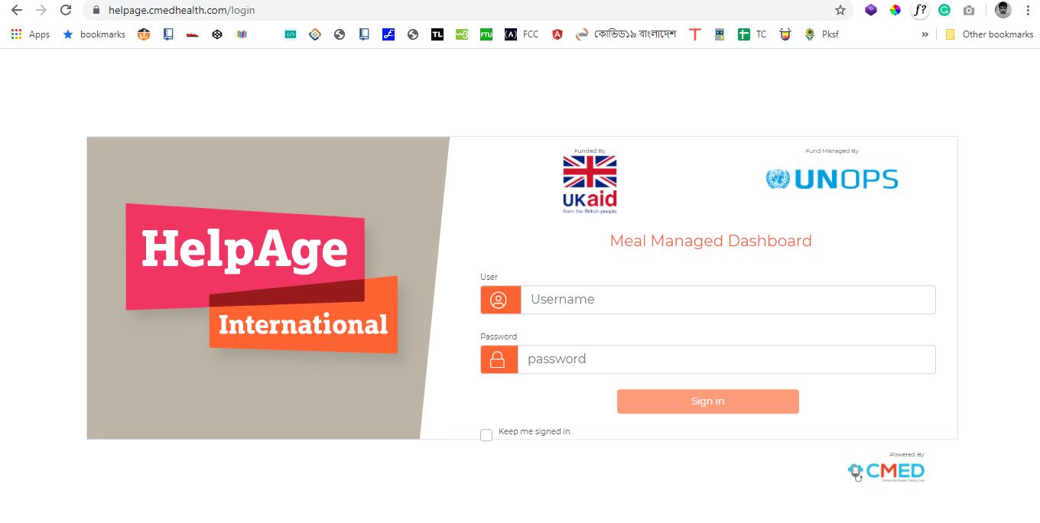
HelpAge Web Application UI

Slide 10
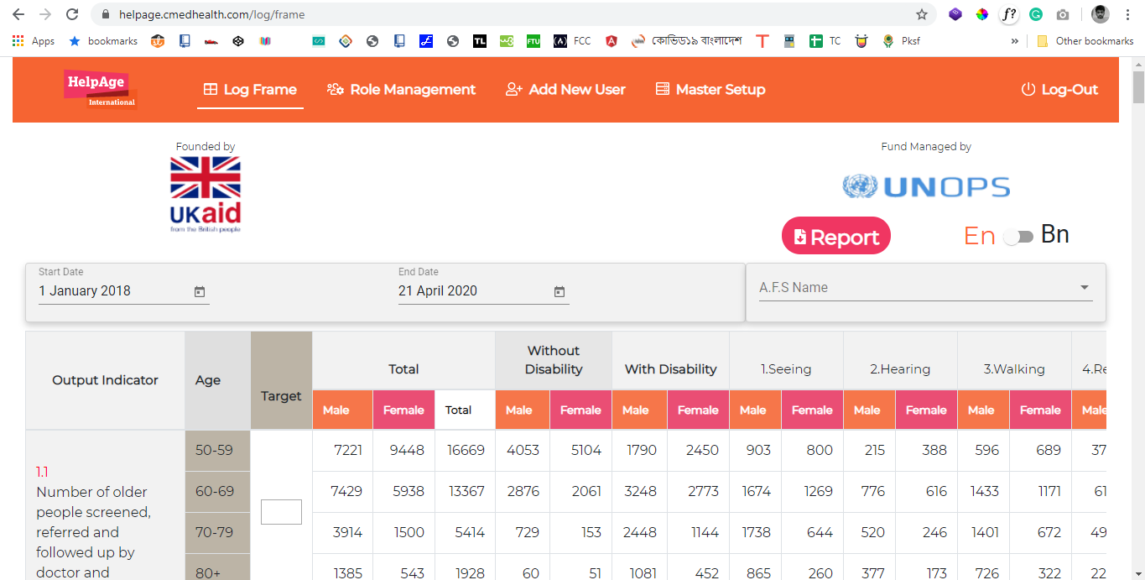
HelpAge Web Application UI

Slide 11
Internship Activities/Works
Tested for data mismatch between Mobile application ,Web dashboard and Swagger API’s. Worked with Backend developer team for this.
Provided support to modifications on the CMED website. Add some pages and content using CMS(WordPress). To adding content on the website, we used Elementor Page Builder and some plugins.

Slide 12
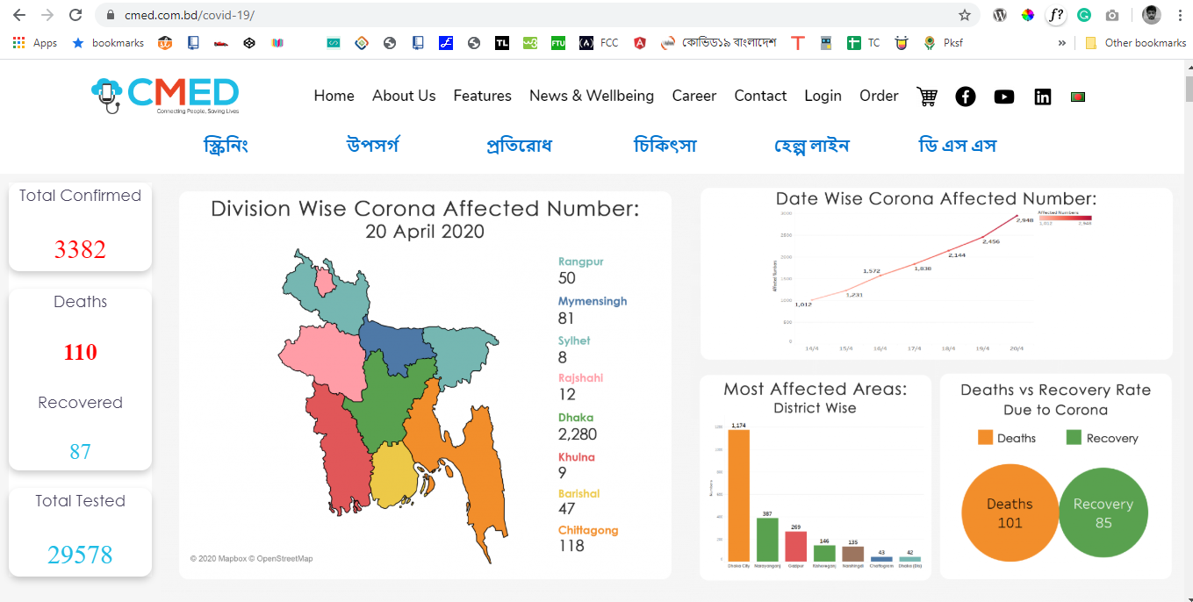
Covid-19 Update page of CMED web

Slide 13
TOOLS USED
CMED Measurement devices: CMED has multiple smart devices for health check up. Had to learn how to use those as major part of our testing depends on those measurement devices.
Slack: Used slack for Communication, Daily target announcement, Check in/Check out messages.
Redmine & Trello : To listed issues/bugs I was using Trello and Redmine those are online corkboards. I use it to compose "cards" into records those cards can be notes, screenshot, shared documents, or whatever else that helps Dev collaboration together.
Swagger : CMED uses swagger to design API’s. When data are a mismatch between the mobile application and web dashboard at that moment need to check APIs.

Slide 14
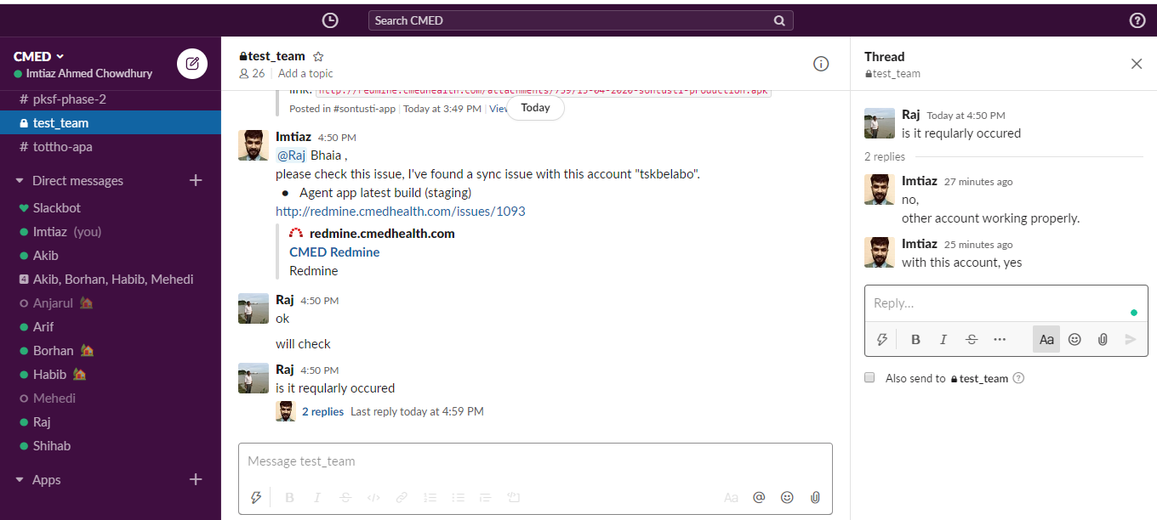
Issues/Bugs Report on Slack

Slide 15
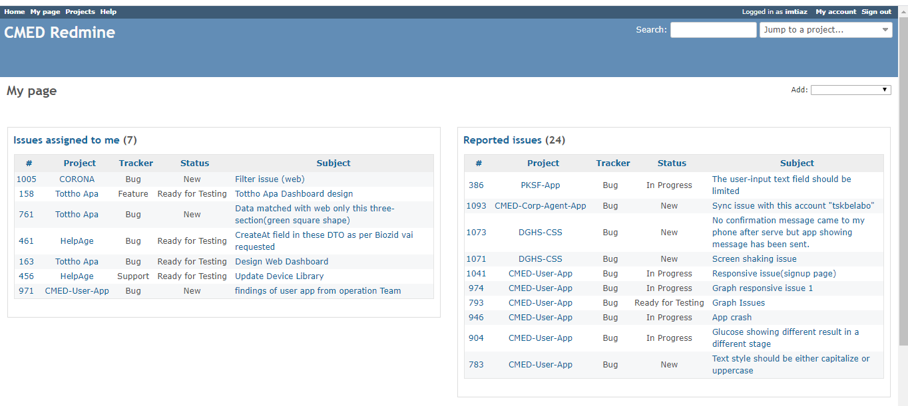
Issues/Bugs Report on Redmine

Slide 16
POINT LEARNED
Time Management
Software Testing
Test Cases Writing
Team Work

Slide 17
THANK YOU

